Slide 1
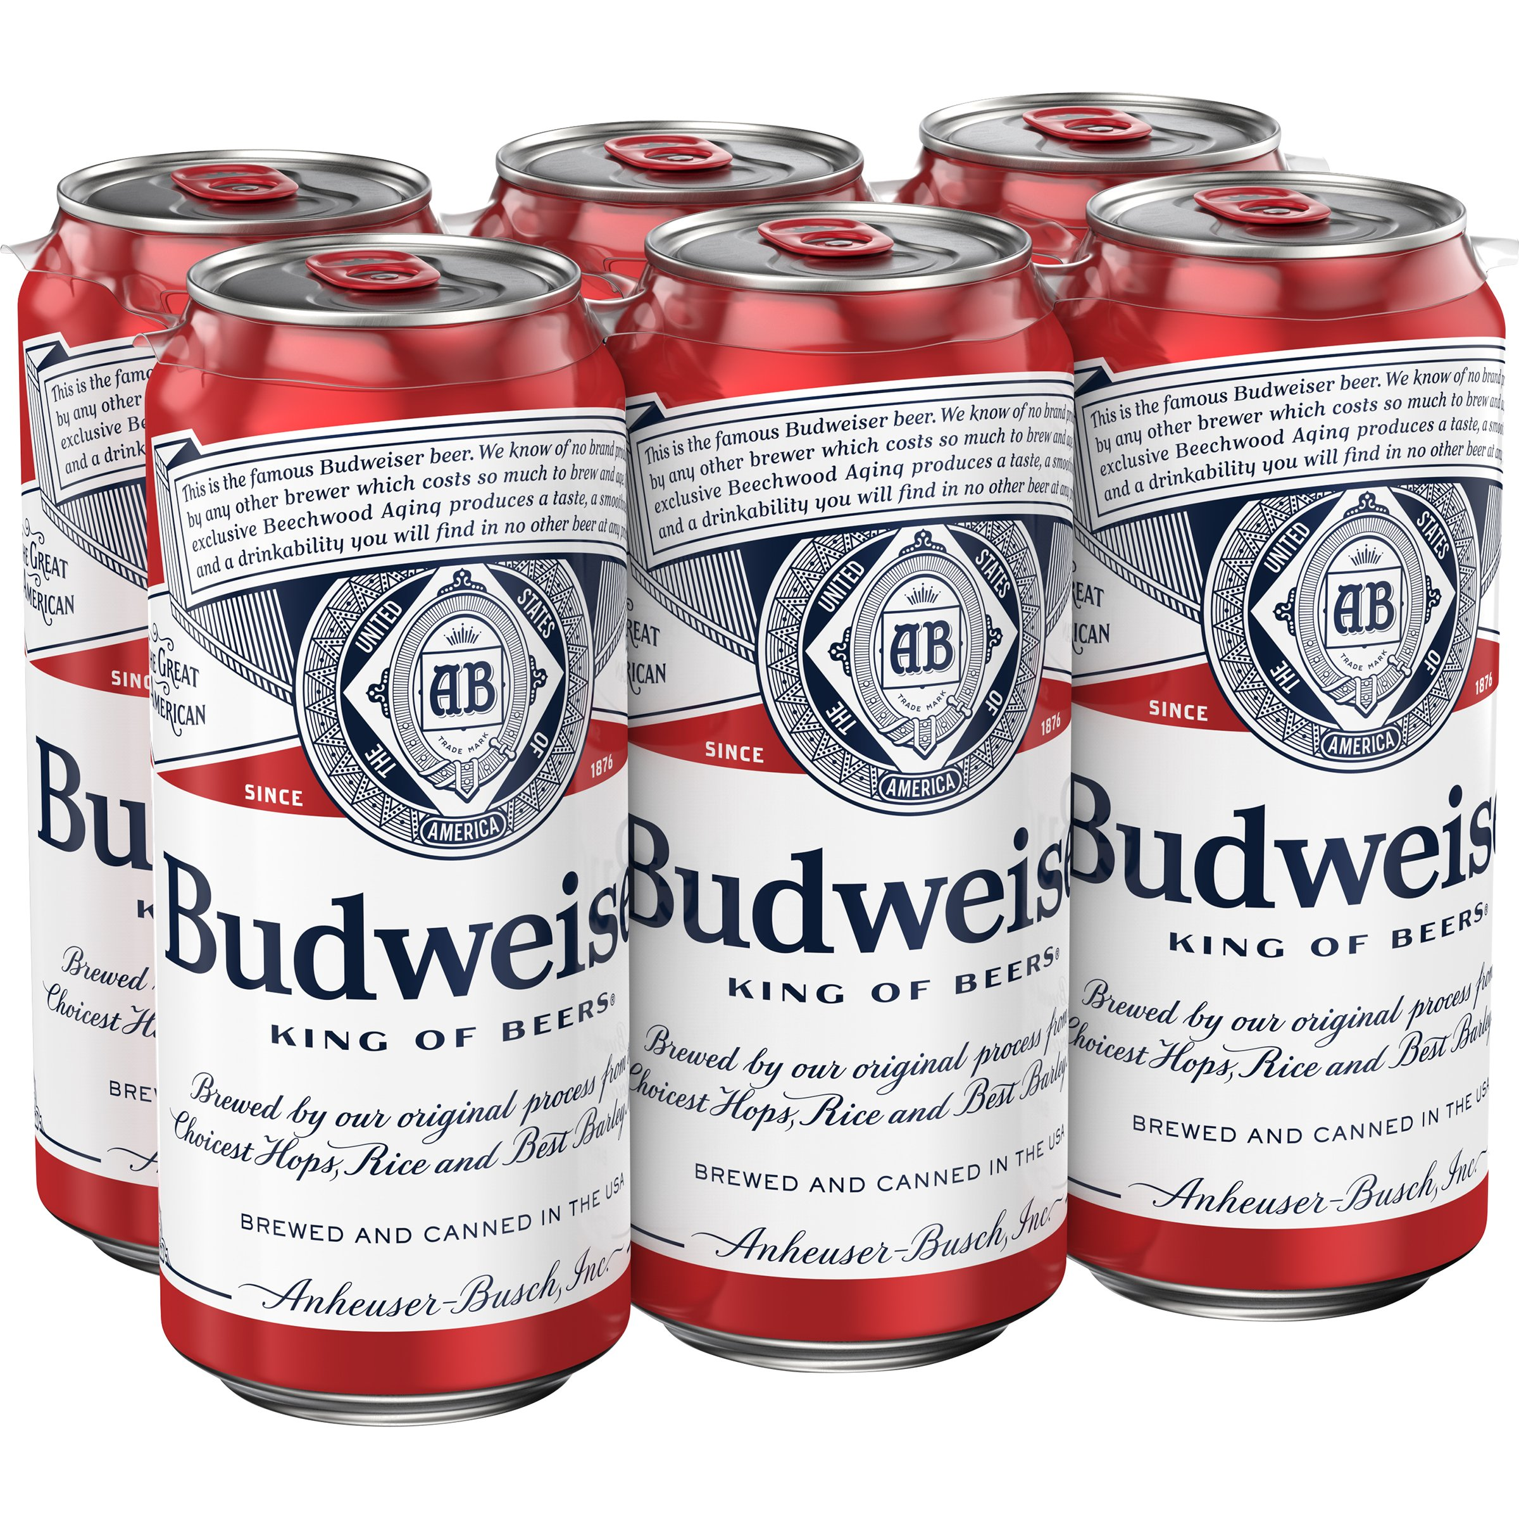
Budweiser
Analytical Insights
White Space Opportunity
October 12, 2021
Shijo Joseph and Douglas Yip

Slide 2
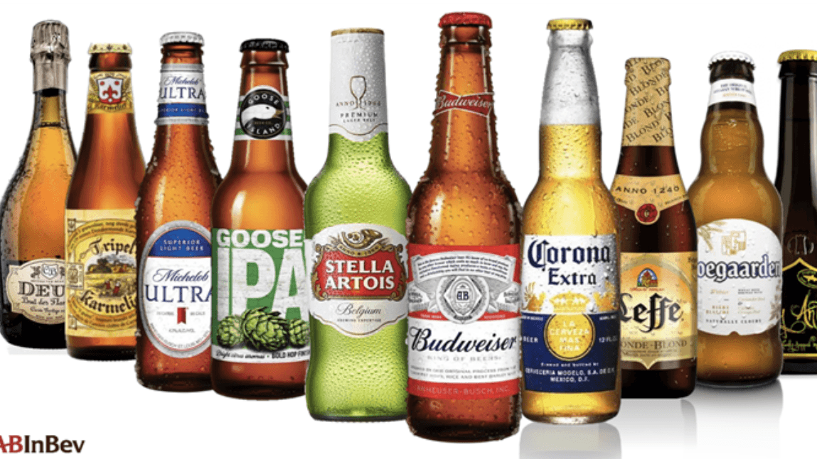
Agenda
The US Brewery and Beer Landscape
ABV and IBU Beer insights
White Space Heat Map Tool
Takeaways and Next steps
Notes:
Speaker NOTE: Agenda for presentation.
SAY: We have conducted an analysis and the purpose of this meeting is to inform you on the potential white space opportunities based on ABV and IBU.
We will give you a brief overview of the landscape
Key insights of from our review.
White Space Heat Map Tool.
Takeaways Next Steps
TRANSITION: Let’s continue …

Slide 3
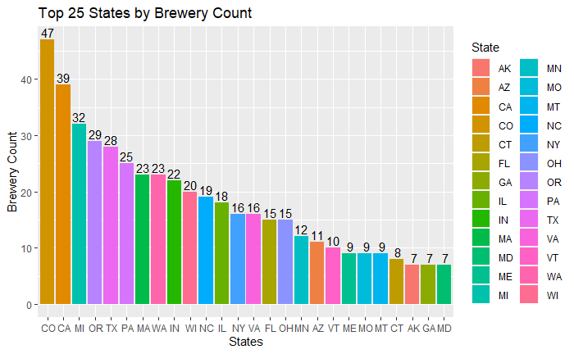
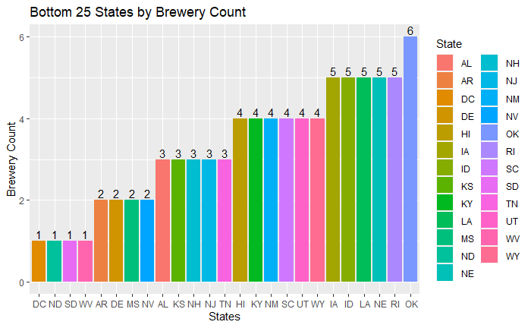
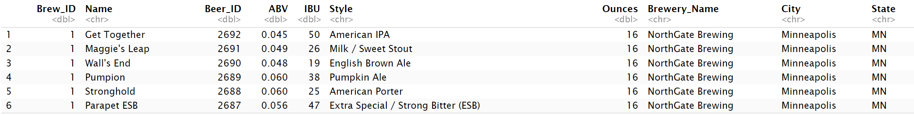
The US Brewery and Beer Landscape
Brewery count by state (Q1)
Beer brands across the US (Q2)
Brewery Competition
Evaluated 558 breweries
Colorado has the highest number of breweries at 47
DC, West Virginia, North/South Dakota have only 1 brewery in their respective states
Beer Brands
We have identified 2410 beer brands
Data facts are incomplete, we omitted 1005 beer brands that had no ABV or IBU associated to the brand in our analysis(Q3)
Notes:
Speaker NOTE: This page provide a high level overview of the US Brewery and Beer Landscape.
SAY: The competitive landscape is very diverse.
SAY: Brewery perspective
We identified 558 breweries.
Colorado had the highest count vs 4 other states only have 1.
Say: Beer perspective
We identified 2410 breweries
Unfortunately, we omitted over a thousand skus from the data that was incomplete. There was fear that extrapolation of either IBU and ABV would have skewed our results.
TRANSITION: Let’s share we learned…

Slide 4
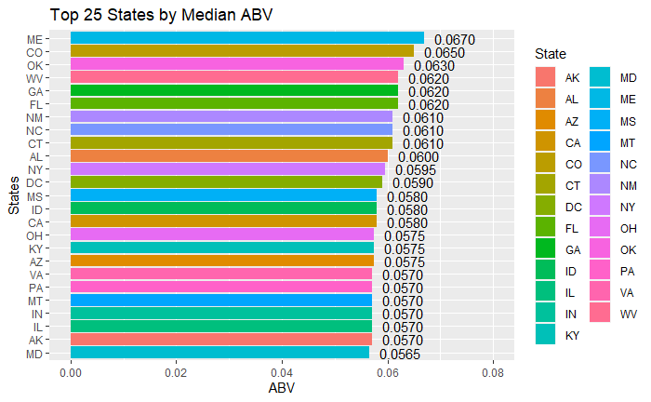
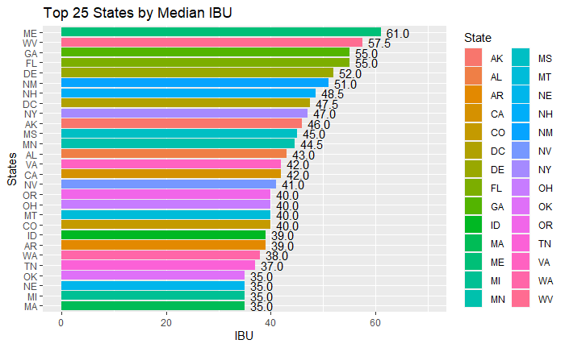
ABV and IBU Beer insights
Top 25 states ABV (Q4)
Top 25 states IBU (Q4)
ABV Insights
Maine has the highest ABV median at 6.7%
The State of Kentucky has the beer with the highest ABV at 12.5% (Q5)
IBU Insights
Maine has the highest IBU median at 61
The state of Oregon has the beer with the highest IBU at 138 (Q5)
Notes:
Speaker NOTE: This page provide the difference in ABV and IBU by State
SAY: Consumer preference varies significantly by state.
SAY: ABV median preference varies from 6.7% to as low as X%
Maine has the highest median at 6.7%
Kentucky sells a beer with the highest ABV at 12.%
SAY: IBU median preference varies from 61 to as low as 19
Maine has the highest median at 61
Oregon sells a beer with the highest ABV at 138
TRANSITION: Let’s double click to see the correlation of ABV and IBU…

Slide 5
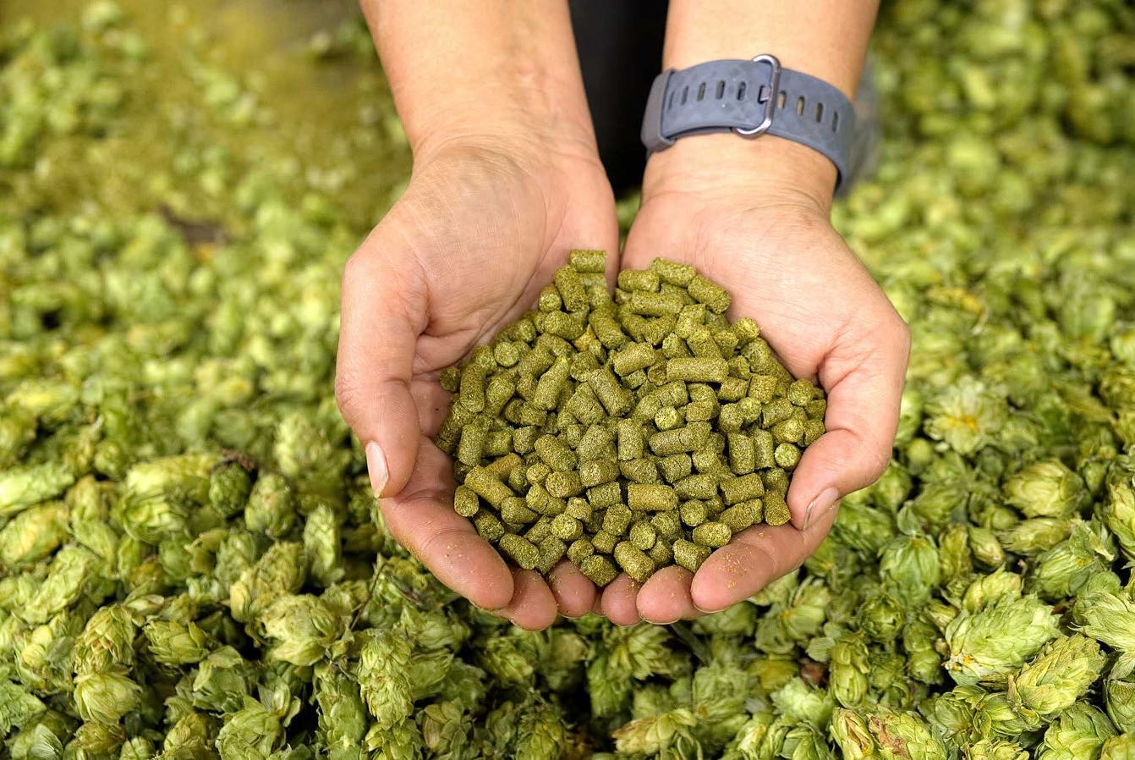
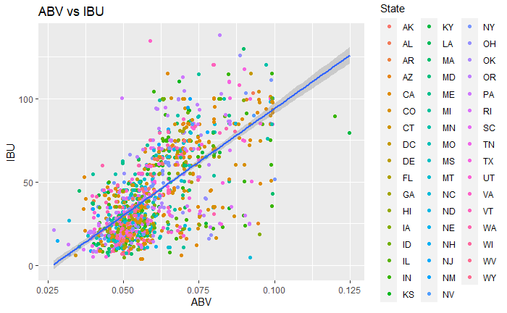
ABV and IBU Beer insights
What we know about Beers
IBU ABV (Q7)
The (IBU) and ABV are highly correlated, the hoppier the beer the higher the ABV (Q7)
ABV distribution showed a right skewed distribution with a mean at 6% and median at 5.7%. Most of the beers ABV ranged between 5% to 6.8% (IQR). (Q6)
Labeling Ales is extremely important to be correct, as the style of ale was correctly labeled 85.7% of the time (knn=5) based the IBU and ABV content. (Q8)
Notes:
Speaker NOTE: This page provide the view of the correlation of the ABV and IBU by beer
SAY: What we know is that ABV and IBU are correlated.
SAY:
Consumer preference of degree hoppiness is dependent on the ABV of the beer.
-We also know that consumers preference in ABV range between 6-6.8% based on the IQR. However we have a right skewed distribution where consumer have preference to higher ABVs.
SAY:
What we also understand the style of the beer is 85.7% accurate based on a knn=5 on ABV and IBU.
Labeling of the style of beer is important as consumer expect a specific ABV and IBU content.
TRANSITION: Let’s share a tool that we created for you…

Slide 6
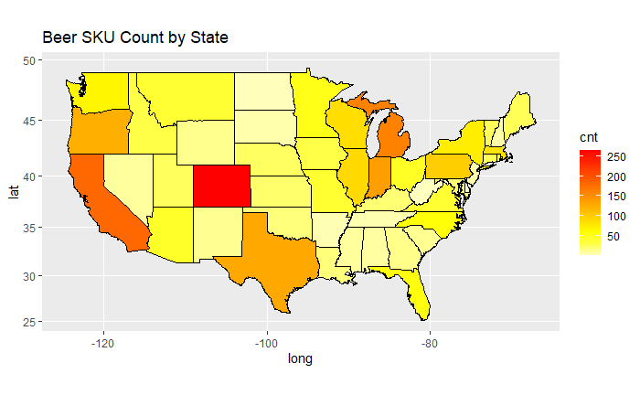
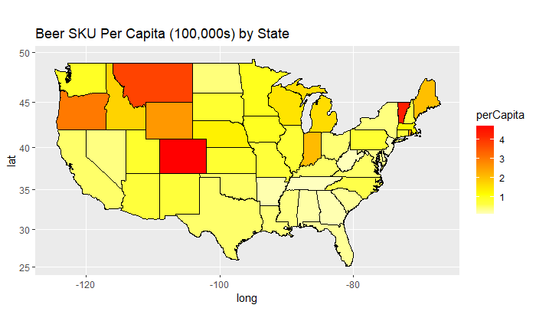
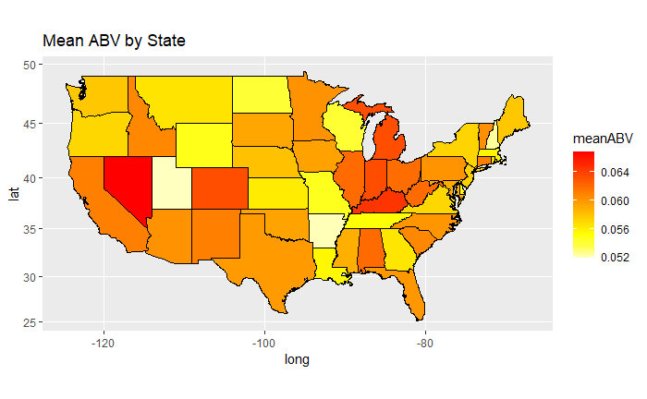
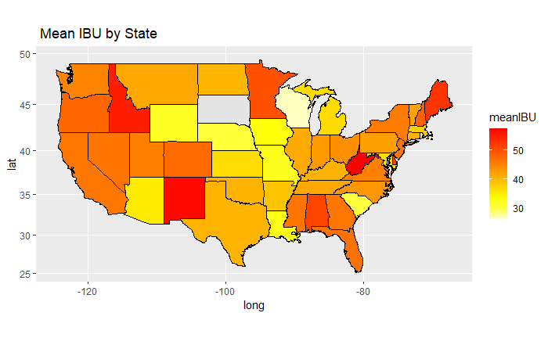
Our Heat map tool can determine where you have the greatest white space opportunities where we customize the style by state
White Space Heat Map Tool (Q9)
White Space Opportunities
The heat maps identifies opportunities by state for Budweiser to expand it portfolio
Consumer offering by state can be customize, by style of beer, based on the ABV and IBU median preference to optimize consumer preference in each State
We recommend that your marketing team utilize our tool to evaluate innovation opportunities within the US SouthEast region
ABV and IBU Preference by State
Notes:
Speaker NOTE: This page contains our white space heat map tool
SAY: This tool will help you customize your innovation pipeline
SAY:
Heat map has the ability to identify states with best opportunity based on the #SKUs per 100,000 capita
We can customize beers by state base on the median ABV and IBU preference
SAY:
We recommend that you allow your marketing team to utilize this tool to help them evaluation the innovation pipeline by state.
This tool a consumer insight based tool.
TRANSITION: Let’s us close this out for you…

Slide 7

Takeaways
Labeling of style of beer is important based on ABV/IBU
As we venture into hoppier beers expect ABV to be higher
Heat Map tool offers insights to innovation opportunities, by states, while customizing the style of beer to maximize consumer preference
Next Steps
Align to taking these insights to your Marketing team to investigate further on this white space opportunity
Notes:
Speaker NOTE: Closing page
SAY: Let’s us give you 3 takeaways from our insights and recommendation
SAY:
Labeling of style of beer is important based on ABV?IBU
ABV and IBU are correlated, so if we produce more hoppier beers, expect higher ABVs
Our Heat Map tool is consumer centric, and we believe you can utilize this in your future innovation opportunities.
SAY:
We want to end to get your alignment to proceed with us to share this tool to your marketing team to further investigate future white space opportunities.
TRANSITION: click to next page…

Slide 8
Thank you!!
Questions
Notes:
Speaker NOTE: Thank You

